Slide 1


CREDIT CARD
WEEKLY STATUS REPORT

Slide 2

CONTENTS
Project objective
Data from SQL
Data processing & DAX
Dashboard & insights
Export & share project

Slide 3



Project Objective
To develop a comprehensive credit card weekly dashboard that provides real-time insights into key performance metrics and trends, enabling stakeholders to monitor and analyze credit card operations effectively.

Slide 4
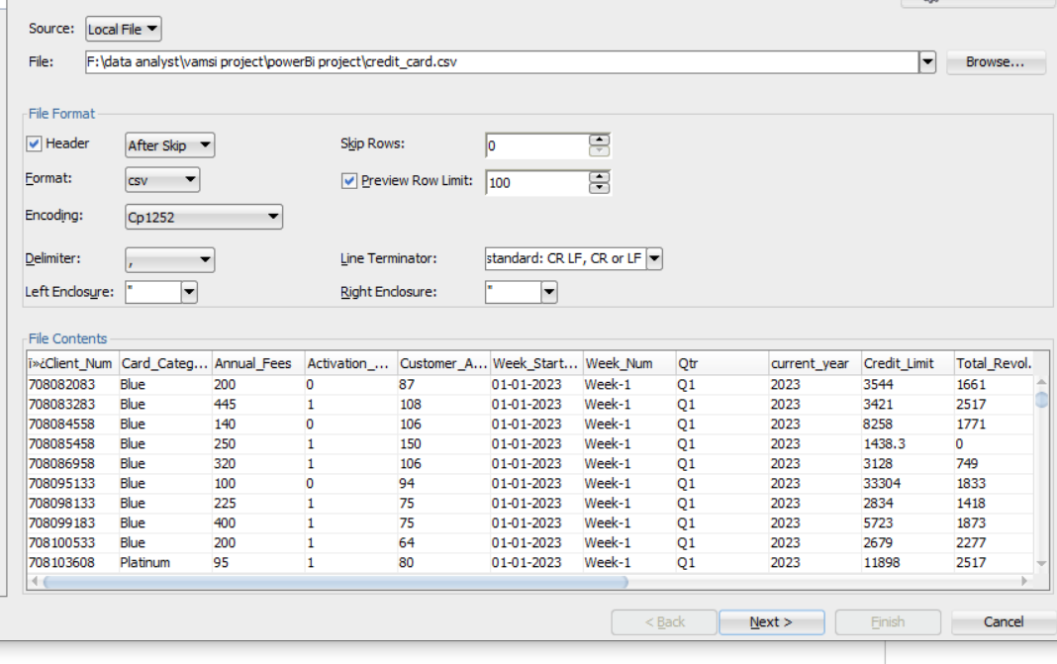





Import data to SQL database
1. Prepare csv file
2. Create tables in SQL
3. import csv file into SQL

Slide 5
DAX Queries
AgeGroup = SWITCH(
TRUE(),
'public cust_detail'[customer_age] < 30, "20-30",
'public cust_detail'[customer_age] >= 30 && 'public cust_detail'[customer_age] < 40, "30-40",
'public cust_detail'[customer_age] >= 40 && 'public cust_detail'[customer_age] < 50, "40-50",
'public cust_detail'[customer_age] >= 50 && 'public cust_detail'[customer_age] < 60, "50-60",
'public cust_detail'[customer_age] >= 60, "60+", "unknown“
)
IncomeGroup = SWITCH(
TRUE(),
'public cust_detail'[income] < 35000, "Low",
'public cust_detail'[income] >= 35000 &&
'public cust_detail'[income] = 70000, "High", "unknown"
)

Slide 6
DAX Queries
week_num2 = WEEKNUM('public cc_detail'[week_start_date])
Revenue = 'public cc_detail'[annual_fees] + 'public cc_detail'[total_trans_amt] + 'public cc_detail'[interest_earned]
Current_week_Reveneue = CALCULATE( SUM('public cc_detail'[Revenue]),
FILTER( ALL('public cc_detail’),
'public cc_detail'[week_num2] = MAX('public cc_detail'[week_num2])))
Previous_week_Reveneue = CALCULATE( SUM('public cc_detail'[Revenue]),
FILTER( ALL('public cc_detail'), 'public cc_detail'[week_num2] = MAX('publiccc_detail'[week_num2])-1))

Slide 7
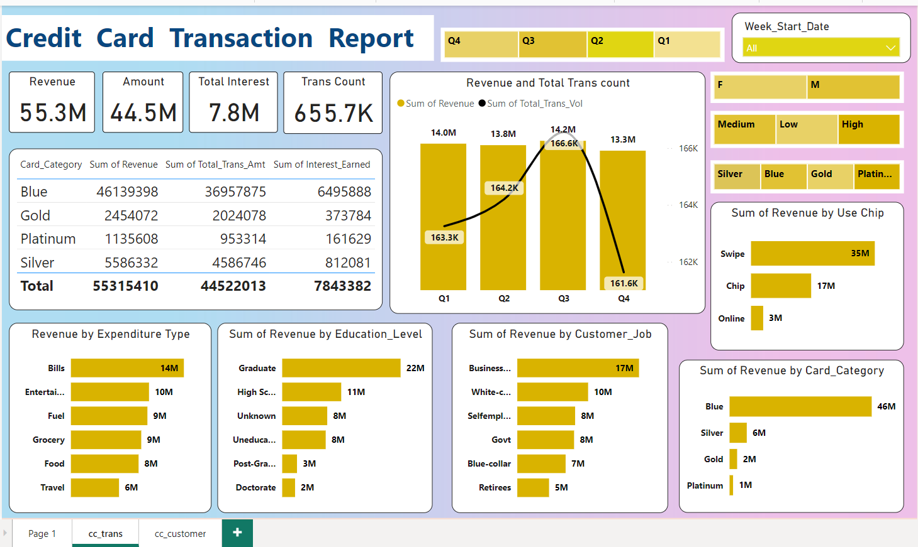
POWER BI
REPORT/ DASHBOARD

Slide 8
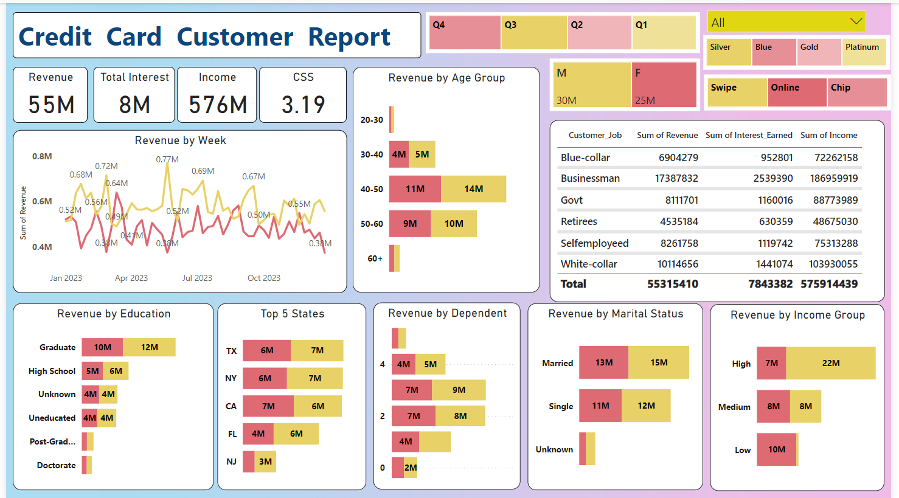
POWER BI
REPORT/ DASHBOARD

Slide 9

Project Insights- Week 53 (31st Dec)
Week on Week (WoW) change:
• Revenue increased by 28.8%,
• Total Transaction Amt & Count increased by 35.03% & 3.39%
• Customer count increased by 14.19%
Overview of Year to Date(YTD):
• Overall revenue is 57M
• Total interest is 8M
• Total transaction amount is 46M
• Male customers are contributing more in revenue 31M, female 26M
• Blue & Silver credit card are contributing to 93% of overall transactions
• TX, NY & CA is contributing to 68%
• Overall Activation rate is 57.5%
• Overall Delinquent rate is 6.06%
• Self-employed having highest Delinquent rate is 1.66%.

Slide 10
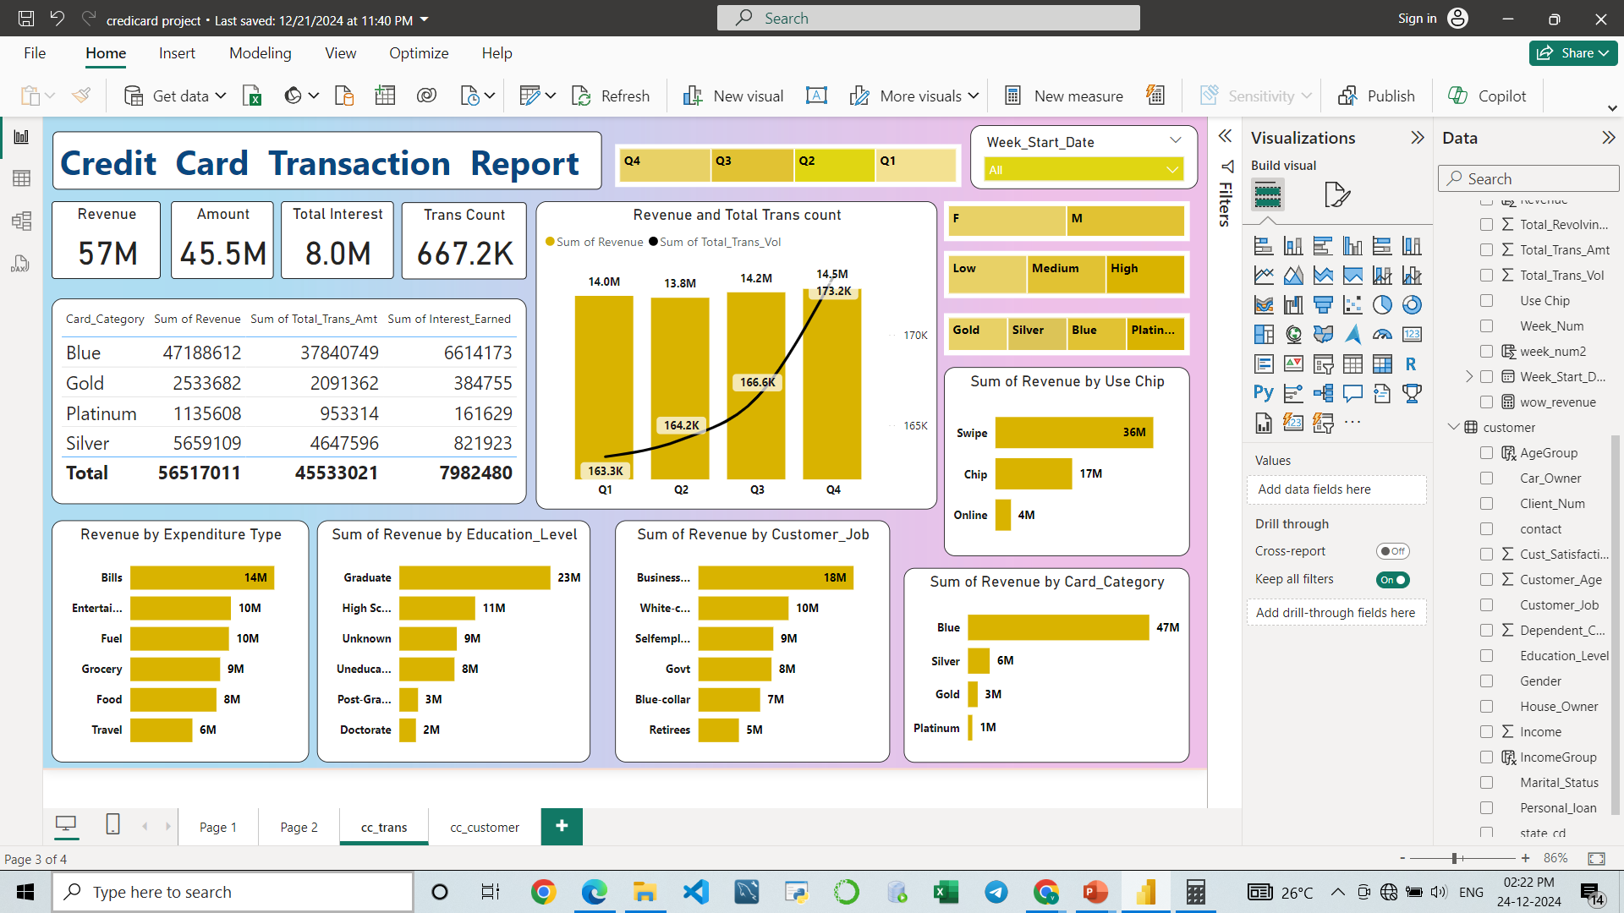
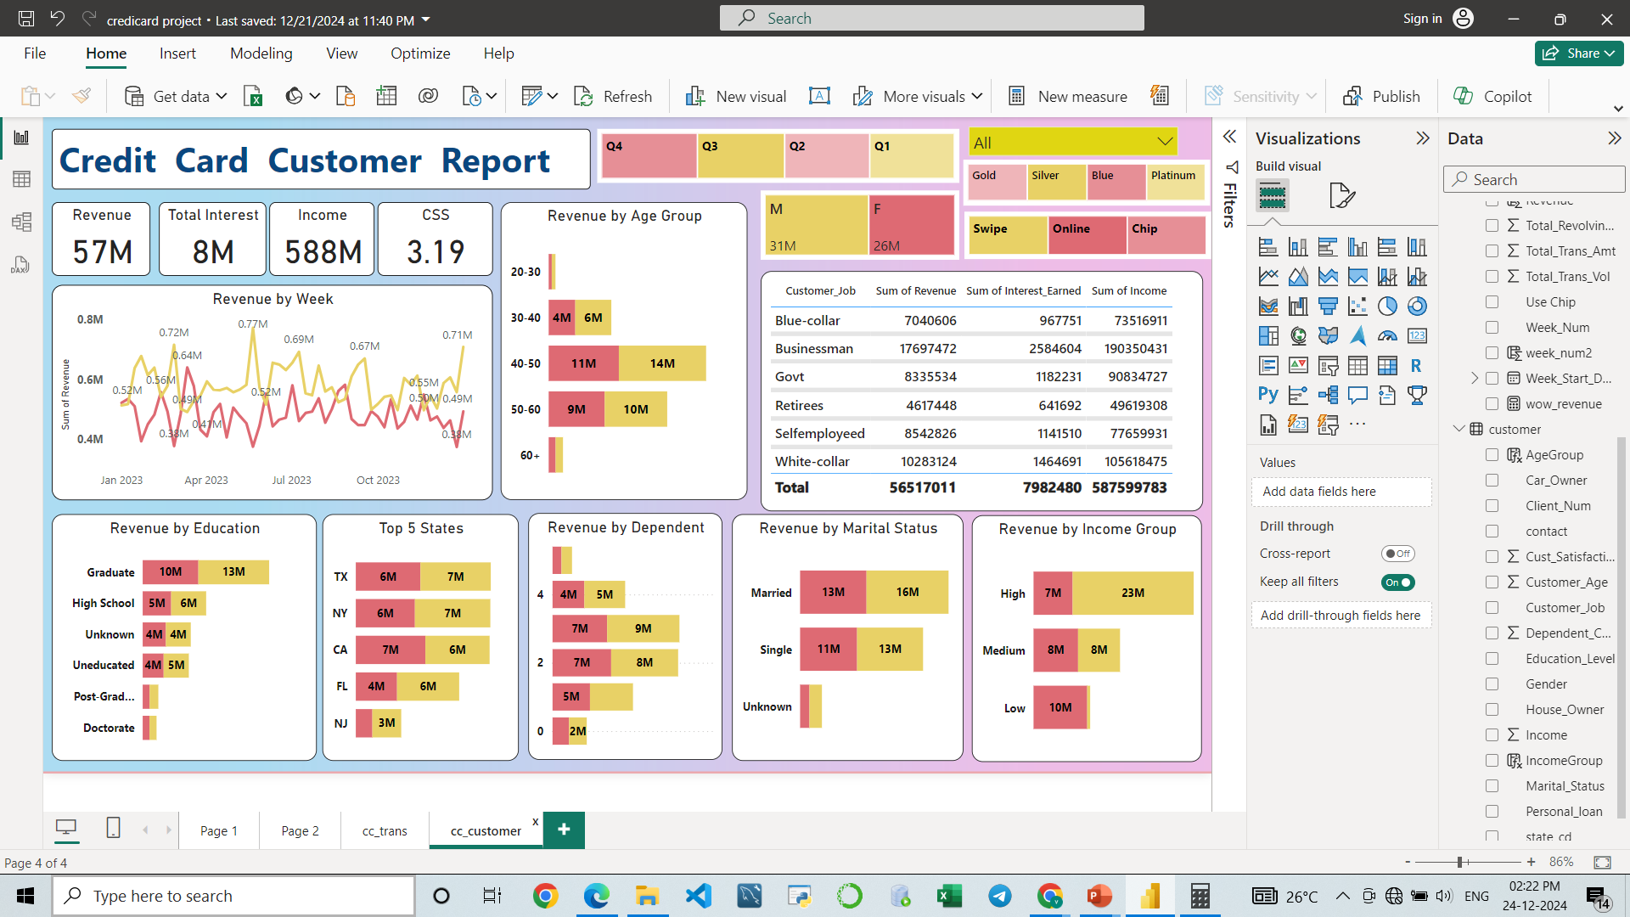
UPDATED WEEK 53 UPTO (31st Dec) DASHBOARD

Slide 11

Download Data
GitHub:
https://github.com/ivamcthor/Credit-Card-weekly-Report
PROJECT BY
SAI VAMSIDHAR ITHA

